Slide 1

HAMBURG RACE PREVIEW
Elite Analysis · July 9 – 12, 2026
USA Triathlon High Performance

Slide 2
Race Week Schedule
Hamburg
July 9 – 12, 2026 • Rathausmarkt / Binnenalster, Hamburg, Germany (CEST, UTC+2)
Thu • July 9
Fri • July 10
Sat • July 11
Sun • July 12
Athlete Check-In / Open Training
Familiarization & Briefing
ELITE SPRINT RACE DAY
Mixed Relay Day
TBD | Athlete check-in and registration — TBD per athlete guide
TBD | Swim / bike / run open training windows — TBD per athlete guide
TBD | Course familiarization — swim, bike, run circuits
TBD | ★ Mandatory Elite athlete briefing
TBD | Race package distribution
11:30 – 12:45 | Elite Men — athletes' lounge check-in + warm-up
12:15 – 13:00 | Elite Men — swim warm-up + transition check
13:10 | Elite Men — athletes' introduction
13:15 | ★ ELITE MEN START
~14:06 | Elite Men — projected finish
14:15 | Elite Men medals ceremony
13:45 – 14:45 | Elite Women — athletes' lounge check-in + warm-up
14:15 – 14:55 | Elite Women — swim warm-up + transition check
14:50 | Elite Women — athletes' introduction
15:00 | ★ ELITE WOMEN START
~15:55 | Elite Women — projected finish
16:05 | Elite Women medals ceremony
Evening | Mixed Relay team declaration
TBD | Mixed Relay team managers' meeting
17:30 | ★ MIXED RELAY START
~18:45 | Mixed Relay projected finish
Post-finish | Mixed Relay medals ceremony
Times Rathausmarkt / Binnenalster, Hamburg, Germany (CEST, UTC+2). Schedule confirmed from World Triathlon race-info page / athlete guide; subject to organiser updates.

Slide 3
Key Course Differentiators
Hamburg
HAMBURG
COURSE AT A GLANCE
WTCS Hamburg is one of the sport's flagship city-center races, set in the heart of Hamburg along the Binnenalster and the historic Rathausmarkt. The sprint format — 750 m Alster swim, 6 × 3.3 km technical urban bike, 2 × 5 km flat run — rewards athletes who can handle high-frequency cornering on the bike and sustain race pace on fresh legs off a large pack. Hamburg has hosted elite triathlon since 2008 and consistently delivers fast, tactical racing in front of one of the largest crowds on the WTCS calendar.
Swim:
750 m – 1 lap
Bike:
19.8 km – 6 laps × 3.3 km
Run:
10 km – 2 laps × 5 km
Format:
Sprint Triathlon (WTCS)
COURSE FEATURES
Bike Laps:
6
Run Laps:
2
• Sheltered 750 m Binnenalster swim — flat calm fresh water, pontoon start, non-wetsuit typical in July.
QUICK LINKS
• 6 × 3.3 km urban bike (19.8 km) — flat but highly technical with multiple turns; large packs form.
Current Race Info:
Race Info | 2026 World Triathlon Championship Series Hamburg
• 2 × 5 km flat run through city-center streets — fast finishing conditions, cobblestone sections.
• Elite Men 13:15 / Elite Women 15:00 Saturday July 11. Mixed Relay Sunday July 12.

Slide 4
Course Profile & Map
Hamburg
[PLACEHOLDER: Insert upcoming course map or race photo here] Right-click → Replace Image, or paste screenshot of the World Triathlon course map PDF.
[PLACEHOLDER: Insert previous year course map or race photo here] Right-click → Replace Image, or paste screenshot of the World Triathlon course map PDF.
2026 Course
2025 Course
Source: [PLACEHOLDER: World Triathlon event page URL]
Source: https://www.triathlon.org/events/event/2025_world_triathlon_championship_series_hamburg
Discipline | Distance | Laps | Terrain / Notes
Swim | 0.8 km | — | [PLACEHOLDER: e.g. Open-water, Bay of Hamburg]
Bike | 19.8 km | 6 | [PLACEHOLDER: e.g. Flat coastal road circuit, closed course]
Run | 5.0 km | 2 | [PLACEHOLDER: e.g. Flat multi-lap, cobblestone city-centre finish]

Slide 5
Swim Course Profile
Hamburg
750 m • single lap
Sheltered urban lake — fresh water, calm conditions
Distance
Layout
Start
750 m
Binnenalster / Kleine Alster
Pontoon start
[Drop swim course map here] Save the organiser map as: ppt files/support/hamburg_swim_course.png It will be embedded automatically on the next run.
Water Temp
Wetsuit
Lap Count
18.0–22.0 °C (expected)
Likely non-wetsuit (20 °C)
1
Tactical Notes
• Single 750 m loop in the sheltered Binnenalster / Kleine Alster — flat, calm, navigation-friendly
• Pontoon start into the Alster canal — fast, mass-start entry with good visibility
• Fresh water lake in city center — no ocean chop, swell, or current; pure positioning swim
• July morning water mid-to-high teens Celsius — bring both wetsuit options; decision made day-of per WT measurement
Source: World Triathlon race info — 2026 WTCS Hamburg
• Short run into T1 from the Alster exit ramp — transition area directly adjacent to city hall

Slide 6
Bike Course Profile
Hamburg
19.8 km • 6 × 3.3 km loops
Closed urban circuit — Rathausmarkt, Alsterufer, Jungfernstieg
[Drop course map here] Save the organiser course map as: ppt files/support/hamburg_bike_course.png It will be embedded automatically on the next run.
Elevation / Lap
Total Climb
Avg Grade
Flat (no data)
—
—
Max Climb Grade
Wind
Loops
—
City-center setting — generally sheltered, variable
6 × 3.3 km
Tactical Implications
• 6 × 3.3 km laps (19.8 km total) around Hamburg's city center — one of the most technical WTCS bike courses
Source: World Triathlon race info — 2026 WTCS Hamburg
• Pancake-flat throughout, but high-frequency turns through Rathausmarkt and along the Alster reward bike-handling over raw power
• Drafting packs form easily on the long straights; Hamburg historically produces large lead packs of 30+ athletes
• Cobblestone sections near the Rathaus and Jungfernstieg add vibration load — check tire pressure pre-race
• Wheel station on each lap — mark position early; packs do not slow for late changes
Flat course — published profile shows no significant climbs. No elevation chart synthesized; if a race GPS FIT becomes available, real contours will replace this block.

Slide 7
Run Course Profile
Hamburg
10.0 km • 2 × 5.0 km
Closed urban — Rathausmarkt, Alsterarkaden, city hall precinct
Distance
Lap Structure
Total Climb
10.0 km
2 × 5.0 km
Not published
[Drop run course map here] Save the organiser map as: ppt files/support/hamburg_run_course.png It will be embedded automatically on the next run.
Avg Grade
Max ▲ / ▼
Heat Risk
—
Not published
LOW–MODERATE
Tactical Notes
• 2 × 5 km laps through Hamburg's historic city center — flat, fast, spectator-dense course
• Cobblestone sections on Rathausmarkt and adjacent squares add vibration; stay relaxed in the upper body
• Wide avenues on most of the loop allow for tactical racing and late-race surges
• 13:15 / 15:00 summer starts — July Hamburg averages ~22 °C, manageable but warm; aid stations every lap
Source: World Triathlon race info — 2026 WTCS Hamburg
• Penalty box positioned at the finish area — drafting tickets from the bike carry into the run

Slide 8
Travel & Arrival Load
Denver, CO → Hamburg race week
Core travel read
Denver → Hamburg requires one or two stops — typical routes connect through London (LHR), Amsterdam (AMS), Frankfurt (FRA), or Paris (CDG) before the short onward hop into Hamburg (HAM). Lufthansa and United operate the most athlete-friendly itineraries from DEN. CEST (UTC+2) is 8 hours ahead of MDT, so plan 3–4 days of pre-race arrival to manage jet lag. Hamburg Airport (HAM) is 10 km from the city center — taxi/rideshare ~20 min, S-Bahn line S1 links the airport to the Hauptbahnhof in ~25 min. Most WTCS hotels sit within 1–2 km of the Alster.
Primary route
Flight time
Time zones
Airport Transfer
Transfer Distance
DEN → HAM
~14–16h
+8h
HAM → City Center
~10 km
1–2 stops (FRA/AMS/LHR typical)
Including layover
CEST ahead of MDT
S-Bahn S1 ~25 min or taxi ~20 min
HAM Airport to Binnenalster
Host Hotel / Official Accommodation
Food / Grocery Options Near Hotel + Venue
• Historic WTCS host hotels cluster along the Außenalster and inner city: Radisson Blu, Fairmont Hotel Vier Jahreszeiten, and NH Hotels are common LOC choices.
• Best stock-up: REWE, Edeka, or Aldi branches within 10 min walk of the Binnenalster area; Hamburger Str / Mönckebergstraße corridor has most options.
• Binnenalster / Rathausmarkt area gives walking distance to transition — no shuttle needed for pre-race check-in or familiarization.
• Quick basics: dm (pharmacy/snack), Starbucks, Backwerk, and bakeries throughout the Rathausmarkt pedestrian zone.
• City centre parking is limited and expensive — most athletes walk or use S-Bahn from the hotel to the venue.
• Athlete-friendly meals: Zum Alten Rathaus, Block House (Hamburg chain, reliable protein), and Superkitchen near the Alster area.
• Check the official 2026 WTCS Hamburg athlete guide (typically released 2–3 weeks prior) for confirmed host hotel and rate codes.
• Race-morning note: T1 / transition area is surrounded by city center — café and bakery options open early for race-morning breakfast.

Slide 9
Environmental Risk Profile
Hamburg
RACE-DAY WEATHER (08:00–11:00 local)
AIR QUALITY (Open-Meteo archive)
Year | Date | Air Temp | Humidity | Wind km/h | Precip mm
2018 | Jul 14 | 21 | 68% | 11 | 0.0
2019 | Jul 06 | 15.0°* | 90% | 15 | 1.1
2020 | Sep 05 | 14.5°* | 85% | 18 | 0.3
2021 | Sep 18 | 15.5°* | 84% | 10 | 0.0
2022 | Jul 09 | 23.4 | 81% | 19 | 0.1
2023 | Jul 15 | 24.4°* | 54% | 14 | 0.0
2024 | Jul 13 | 18.9 | 74% | 22 | 0.1
2025 | Jul 12 | 23.6 | 77% | 14 | 0.8
Year | PM2.5 | EU AQI | UV Index | Risk
2018 | 2.5 | 19 | — | Good
2019 | 6.2 | 14 | — | Good
2020 | 4.8 | 17 | — | Good
2021 | 3.8 | 10 | — | Good
2022 | 4.7 | 15 | — | Good
2023 | 6.5 | 35 | 2.8 | Fair
2024 | 3.6 | 21 | 1.2 | Fair
2025 | 5.7 | 21 | 1.5 | Fair
HEALTH & WATER QUALITY RISK FACTORS
• Water Quality: [PLACEHOLDER: Historical water quality data for Hamburg — e.g. bacterial counts, EU Bathing Water Directive status, known algae / pollution events. Check local environmental agency reports for May race window.]
• Athlete Health Incidents: [PLACEHOLDER: Any known GI illness, respiratory, or heat-related incidents at this or comparable venues. E.g. Sunderland 2023 — reported GI illness post-swim for multiple athletes.]
• Water Temperature: [PLACEHOLDER: Historical open-water temperature for Hamburg in May (not available from Open-Meteo; check Copernicus Marine / NOAA or WT historical results).]
• Heat / Humidity Risk: Auto-derived from above table — flag if humidity >70% or air temp >25°C at race time.
Weather and AQ data: Open-Meteo historical archive (archive-api.open-meteo.com). EU AQI: Good ≤20, Fair ≤40, Moderate ≤60, Poor ≤80, Very Poor >80.

Slide 10
Who to Watch — Hamburg Race Week
ELITE MEN
ELITE WOMEN
Top 10 by World Ranking
Top 10 by World Ranking
Rank | Athlete | Points
1 | Vasco Vilaca | 6,789
2 | Miguel Hidalgo | 6,703
3 | Matthew Hauser | 6,341
4 | Henry Graf | 5,726
5 | David Cantero Del Campo | 5,062
6 | Csongor Lehmann | 5,030
7 | Dorian Coninx | 4,545
8 | Luke Willian | 4,534
9 | Ricardo Batista | 4,458
10 | Alessio Crociani | 3,921
Rank | Athlete | Points
1 | Beth Potter | 7,399
2 | Lisa Tertsch | 6,914
3 | Jeanne Lehair | 6,295
4 | Leonie Periault | 6,170
5 | Cassandre Beaugrand | 5,591
6 | Jolien Vermeylen | 5,111
7 | Taylor Spivey | 4,879
8 | Emma Lombardi | 4,767
9 | Diana Isakova | 4,677
10 | Bianca Seregni | 4,659
Last Year's Podium at Hamburg
Last Year's Podium at Hamburg
1. Matthew Hauser (00:50:07)
1. Leonie Periault (00:56:25)
2. Vasco Vilaca (00:50:14)
2. Cassandre Beaugrand (00:56:29)
3. Alessio Crociani (00:50:36)
3. Beth Potter (00:56:32)
Rankings = current World Triathlon rankings snapshot; startlist intersect uses program_entries when available.

Slide 11
Top Swim Threats
Hamburg
Ranked by EWMA swim split (span-5, most recent) • Lead Pack % = within 15 s of swim leader • WTCS / Championship Finals
ELITE MEN
ELITE WOMEN
# | Athlete | Lead Pack % | Avg Gap (s) | EWMA Swim | Races
1 | Jan Diener | 50% | +13.5 | 8:38 | 2
2 | Kauê Willy | 50% | +21.5 | 8:43 | 2
3 | Gjalt Panjer | 50% | +14.0 | 8:51 | 2
4 | Kyle Smith | 0% | +28.0 | 8:53 | 2
5 | Jannik Schaufler | 0% | +19.7 | 9:01 | 3
6 | Brayden Mercer | 100% | +10.5 | 9:01 | 2
7 | James Edgar | 0% | +27.5 | 9:10 | 4
# | Athlete | Lead Pack % | Avg Gap (s) | EWMA Swim | Races
1 | Cecilia Perez | 0% | +33.0 | 9:36 | 2
2 | Carlotta Missaglia | 0% | +44.0 | 9:49 | 2
3 | Karolina Helga Horváth | 0% | +23.5 | 9:50 | 2
4 | Sandra Dodet | 0% | +40.5 | 9:50 | 2
5 | Nele Dequae | 0% | +50.0 | 9:56 | 2
6 | Margot Garabedian | 0% | +25.5 | 10:01 | 2
7 | Julia Bröcker | 0% | +34.7 | 10:09 | 3
U23 MEN
U23 WOMEN
# | Athlete | Lead Pack % | Avg Gap (s) | EWMA Swim | Races
1 | Pavel Sorokin | 100% | +11.0 | 17:41 | 2
2 | Jules Rethoret | 100% | +11.5 | 17:41 | 2
3 | Esteban Basanta Fouz | 50% | +14.0 | 17:43 | 2
4 | Mitch Kolkman | 100% | +10.8 | 17:50 | 4
5 | Nicolas Probert Vargas | 50% | +27.5 | 17:54 | 2
6 | Sebastian Wernersen | 25% | +22.0 | 18:00 | 4
7 | Alessio Crociani | 100% | +0.0 | 18:06 | 2
# | Athlete | Lead Pack % | Avg Gap (s) | EWMA Swim | Races
1 | Tara Sosinski | 100% | +6.5 | 18:45 | 2
2 | Angelica Prestia | 100% | +9.5 | 18:48 | 2
3 | Sophia Howell | 100% | +1.0 | 19:03 | 3
4 | Selina Klamt | 50% | +19.5 | 19:04 | 2
5 | Jessica Fullagar | 50% | +20.0 | 19:05 | 2
6 | Ilona Hadhoum | 100% | +4.0 | 19:13 | 2
7 | Heidi Juránková | 0% | +45.5 | 19:19 | 2

Slide 12
USA World Rankings Snapshot
Hamburg
As of 2026-07-06 • World Triathlon Rankings • Heading into Hamburg • Race tier: WTCS
Max Points Available at this Race
Win
Podium
Top 5
Top 10
Top 15
Top 20
1,000 pts
855 pts
732 pts
495 pts
335 pts
227 pts
ELITE MEN
ELITE WOMEN
Rank | Athlete | Points | Curr | Prev
16 | John Reed | 3,147 | 6 | 6
26 | Reese Vannerson | 2,628 | 6 | 6
49 | Braxton Legg | 2,088 | 6 | 6
55 | Morgan Pearson | 2,026 | 4 | 5
64 | Sullivan Middaugh | 1,910 | 6 | 6
67 | Chase McQueen | 1,839 | 6 | 6
68 | Keller Norland | 1,835 | 6 | 6
75 | Seth Rider | 1,748 | 6 | 5
83 | Blake Bullard | 1,696 | 6 | 6
100 | Darr Smith | 1,544 | 6 | 6
117 | Porter Middaugh | 1,335 | 6 | 4
119 | Zach Leachman | 1,330 | 6 | 1
166 | Carter Stuhlmacher | 1,044 | 6 | 3
309 | Luke Anthony | 520 | 2 | 6
333 | Matthew McGoey | 466 | 6 | 5
Rank | Athlete | Points | Curr | Prev
7 | Taylor Spivey | 4,879 | 6 | 3
26 | Gwen Jorgensen | 2,674 | 6 | 6
28 | Gina Sereno | 2,667 | 5 | 6
35 | Danielle Orie | 2,432 | 6 | 6
47 | Erika Ackerlund | 2,055 | 5 | 6
53 | Naomi Ruff | 1,988 | 6 | 6
58 | Kelly Wetteland | 1,858 | 6 | 4
84 | Kirsten Kasper | 1,551 | 5 | 2
85 | Eleanor Beveridge | 1,544 | 6 | 6
94 | Joy Gill | 1,479 | 6 | 3
102 | Michelle Magnani | 1,365 | 6 | 6
115 | Rachel Werking | 1,253 | 6 | 1
142 | Ellison Wolfe | 1,085 | 6 | 2
151 | Katie McCune | 1,042 | 6 | 1
160 | Taylor Knibb | 1,003 | 2 | 1

Slide 13
Olympic Qualification Pace
Hamburg
Paris 2024 OQR cutoff (30th): 3,626.69 pts ÷ 12-event cap = 302 pts / event on pace
An athlete who averages ~302 pts per event across their best 12 events is on pace to clear the LA 2028 qualifying threshold.
FINISH POSITION AT EACH TIER THAT HITS 302-PT PACE
Tier | Win pts | Last on-pace pos | First off-pace pos (pts) | Verdict
World Championship Series | 1000 | #16 | #17 (287 pts) | Top 16
World Cup | 500 | #7 | #8 (290 pts) | Top 7
Continental Championships (Americas) | 590 | #9 | #10 (293 pts) | Top 9
Continental Cup (Americas) | 280 | None (win = 280) | — | Not achievable
USA MEN
USA WOMEN
Rk | Athlete | Total | Races | On | Off | Pace | Proj @12
8 | Reese Vannerson | 980 | 2 | 2 | 0 | 490 | 5,884
16 | Chase McQueen | 764 | 3 | 1 | 2 | 254 | 3,059
21 | Sullivan Middaugh | 677 | 2 | 1 | 1 | 338 | 4,063
27 | John Reed | 579 | 1 | 1 | 0 | 579 | 6,953
30 | Braxton Legg | 564 | 2 | 1 | 1 | 282 | 3,384
33 | Seth Rider | 534 | 2 | 1 | 1 | 267 | 3,209
35 | Keller Norland | 519 | 1 | 1 | 0 | 519 | 6,234
41 | Blake Bullard | 436 | 2 | 0 | 2 | 218 | 2,621
77 | Zach Leachman | 212 | 1 | 0 | 1 | 212 | 2,545
87 | Cole Jamieson | 169 | 1 | 0 | 1 | 169 | 2,038
103 | Porter Middaugh | 115 | 1 | 0 | 1 | 115 | 1,380
Rk | Athlete | Total | Races | On | Off | Pace | Proj @12
9 | Danielle Orie | 1,146 | 4 | 2 | 2 | 286 | 3,439
12 | Taylor Knibb | 921 | 2 | 2 | 0 | 460 | 5,526
18 | Gina Sereno | 704 | 2 | 1 | 1 | 352 | 4,226
26 | Taylor Spivey | 579 | 1 | 1 | 0 | 579 | 6,953
31 | Eleanor Beveridge | 519 | 2 | 0 | 2 | 259 | 3,114
36 | Gwen Jorgensen | 495 | 1 | 1 | 0 | 495 | 5,949
39 | Kelly Wetteland | 462 | 1 | 1 | 0 | 462 | 5,550
40 | Naomi Ruff | 460 | 1 | 1 | 0 | 460 | 5,526
86 | Rachel Werking | 181 | 1 | 0 | 1 | 181 | 2,178
90 | Joy Gill | 167 | 1 | 0 | 1 | 167 | 2,014
103 | Kirsten Kasper | 112 | 1 | 0 | 1 | 112 | 1,353
On = events scoring ≥ pace. Off = events < pace. Pace = total breakdown pts ÷ events raced. Proj @12 = current total + (avg pts × remaining events to cap); green if ≥ Paris cutoff. Cutoff estimate: Paris 2024 = 3,627 pts / 12 events = 302 pts/event. Tier positions use a geometric 0.925 points model. Source: World Triathlon rankings database.

Slide 14
USA Olympic Qualification Snapshot
Hamburg
As of 2026-07-06 • Olympic Qualification Rankings (LA 2028 cycle) • Heading into Hamburg
ELITE MEN
ELITE WOMEN
Rank | Athlete | Points | Second | First
8 | Reese Vannerson | 980 | 0 | 2
16 | Chase McQueen | 764 | 0 | 3
21 | Sullivan Middaugh | 677 | 0 | 2
27 | John Reed | 579 | 0 | 1
30 | Braxton Legg | 564 | 0 | 2
33 | Seth Rider | 534 | 0 | 2
35 | Keller Norland | 519 | 0 | 1
41 | Blake Bullard | 436 | 0 | 2
77 | Zach Leachman | 212 | 0 | 1
87 | Cole Jamieson | 169 | 0 | 1
103 | Porter Middaugh | 115 | 0 | 1
125 | Carter Stuhlmacher | 71 | 0 | 1
Rank | Athlete | Points | Second | First
9 | Danielle Orie | 1,146 | 0 | 4
12 | Taylor Knibb | 921 | 0 | 2
18 | Gina Sereno | 704 | 0 | 2
26 | Taylor Spivey | 579 | 0 | 1
31 | Eleanor Beveridge | 519 | 0 | 2
36 | Gwen Jorgensen | 495 | 0 | 1
39 | Kelly Wetteland | 462 | 0 | 1
40 | Naomi Ruff | 460 | 0 | 1
86 | Rachel Werking | 181 | 0 | 1
90 | Joy Gill | 167 | 0 | 1
103 | Kirsten Kasper | 112 | 0 | 1
115 | Michelle Magnani | 71 | 0 | 1
Rankings: latest weekly snapshot. Second / First = events counted in the second vs first scoring period of the LA 2028 OQR cycle. Because the cycle is still in its first year, most results appear under First. Source: World Triathlon rankings database.

Slide 15
ELITE MEN

Slide 16
Race Overview — Elite Men
Hamburg
RACE HISTORY AT HAMBURG
3 KEYS TO SUCCESS
The Elite Men race at Hamburg has been held 8 times in this analysis window (2018–2025). Hayden Wilde is the most successful athlete in this span with 2 victories. The event is staged as part of the World Championship Series / World Championships, World Championship Series calendar. [PLACEHOLDER: Add 1–2 sentences on notable storylines, competitive history, or what makes this event significant for Elite Men athletes. E.g. defending champions, record performances, dramatic finishes.]
1
Swim positioning matters — an average of 18 athletes exit the water within 15 sec of the leader. Entering the bike in the front pack is critical; conserve energy with a disciplined swim line rather than sprinting alone.
2
[PLACEHOLDER: Key 2 — Describe bike strategy: is this a pack race or do breakaways form? What power/tactics are needed to stay in the lead group?]
3
Run speed separates the podium — the fastest run pace averages ~1:18/km with a ~60s spread between fastest and average finisher. Either a pre-built lead from the bike or exceptional run speed is required to win.

Slide 17
Results Summary — Elite Men
Hamburg
Year | Date | Category | Field | DNF/LAP/DNS | Winner | Winner Time | Air Temp | Water Temp | Swim km | Bike km | Run km
2018 | Jul 14 | World Championship Series | 56 | 9 | Mola | 53:24 | 21 | 20.9 | 0.75 | 21.0 | 5.0
2019 | Jul 06 | World Championship Series * | 56 | 9 | Birtwhistle | 55:09 | 15.0°* | — | — | — | —
2020 | Sep 05 | World Championships, World Championship Series | 65 | 7 | Luis | 49:13 | 14.5°* | — | — | — | —
2021 | Sep 18 | World Championship Series | 52 | 4 | Hellwig | 53:08 | 15.5°* | — | — | — | —
2022 | Jul 09 | World Championship Series * | 57 | 3 | Wilde | 53:10 | 23.4 | 20.8 | 0.75 | 21.0 | 5.0
2023 | Jul 15 | World Championships, World Championship Series, Age-Group Event * | 60 | 1 | Wilde | 19:26 | 24.4°* | — | 0.30 | 7.5 | 1.75
2024 | Jul 13 | World Championship Series * | 57 | 7 | Hauser | 50:03 | 18.9 | 21.3 | 0.75 | 19.8 | 4.9
2025 | Jul 12 | World Championship Series * | 55 | 6 | Hauser | 50:07 | 23.6 | 21.1 | 0.75 | 19.8 | 5.0
* Course distance changed vs. prior year

Slide 18
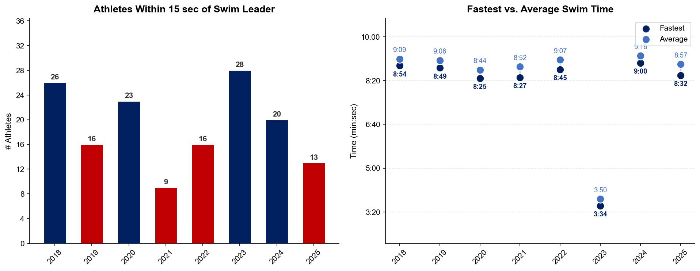
Swim Exit Dynamics — Elite Men
Hamburg

Slide 19
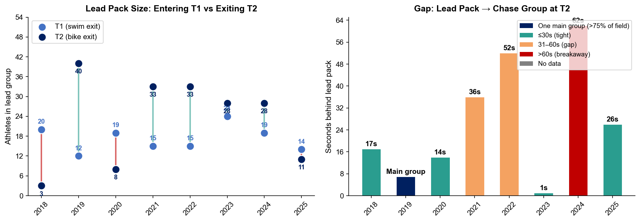
Bike Pack Evolution — Elite Men
Hamburg
Lead pack = athletes within 15 sec of leader. T1 = lead group entering the bike; T2 = lead group exiting the bike.
Year | Lead Size @ T1 | Lead Size @ T2 | Change | Chase Group @ T2 | Chase Gap*
2018 | 20 | 3 | -17 | 37 | 17s
2019 | 12 | 40 | +28 | 2 | 28s
2020 | 19 | 8 | -11 | 34 | 14s
2021 | 15 | 33 | +18 | 9 | 36s
2022 | 15 | 33 | +18 | 13 | 52s
2023 | 24 | 28 | +4 | 23 | 1s
2024 | 19 | 28 | +9 | 16 | 62s
2025 | 14 | 11 | -3 | 20 | 26s
Lead pack = athletes within 15 sec of leader. Chase group = athletes within 15 sec of the first athlete outside the lead pack. * Chase Gap = seconds from the last lead-pack athlete to the first chase-group athlete at T2.
Dropouts: 2018: 8 DNF/LAP (1 in lead group at t1) | 2019: 8 DNF/LAP | 2020: 6 DNF/LAP (1 in lead group at t1) | 2021: 2 DNF/LAP | 2022: 1 DNF/LAP | 2024: 5 DNF/LAP (1 in lead group at t1) | 2025: 6 DNF/LAP (1 in lead group at t1)

Slide 20
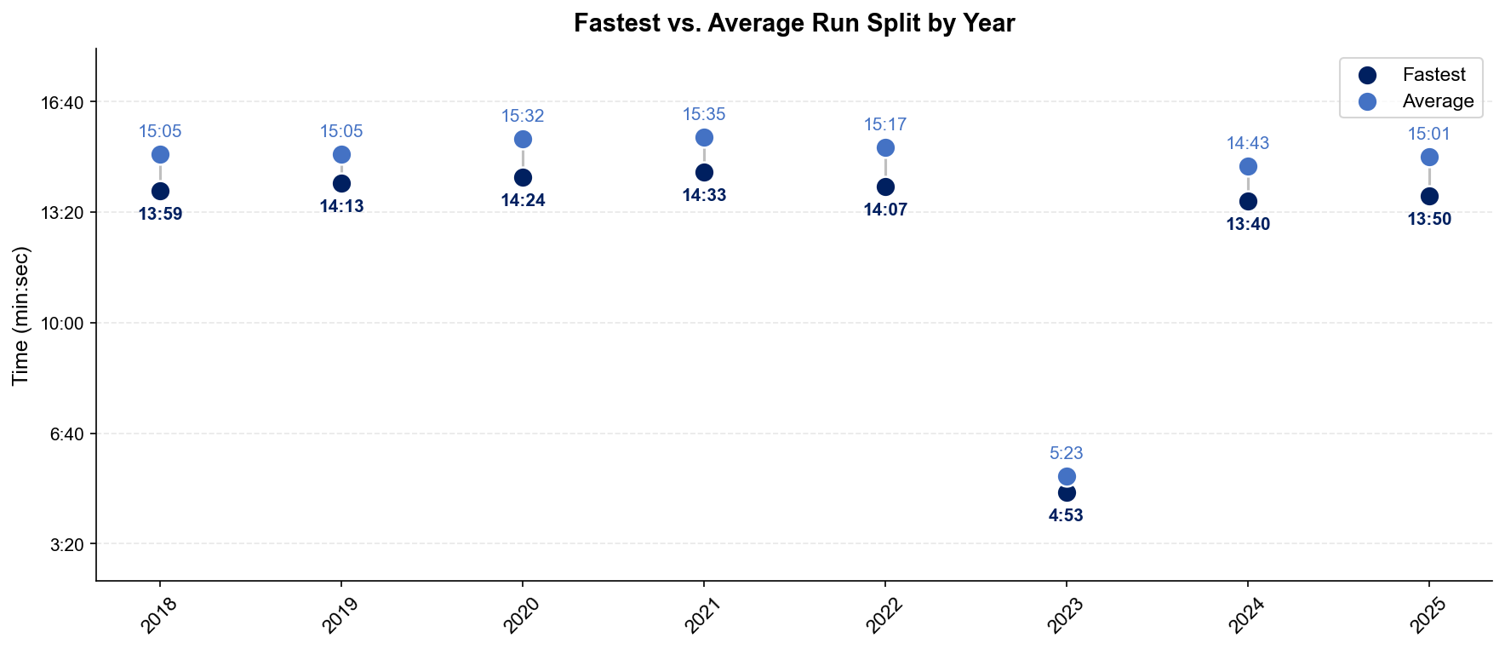
Run Split Analysis — Elite Men
Hamburg

Slide 21
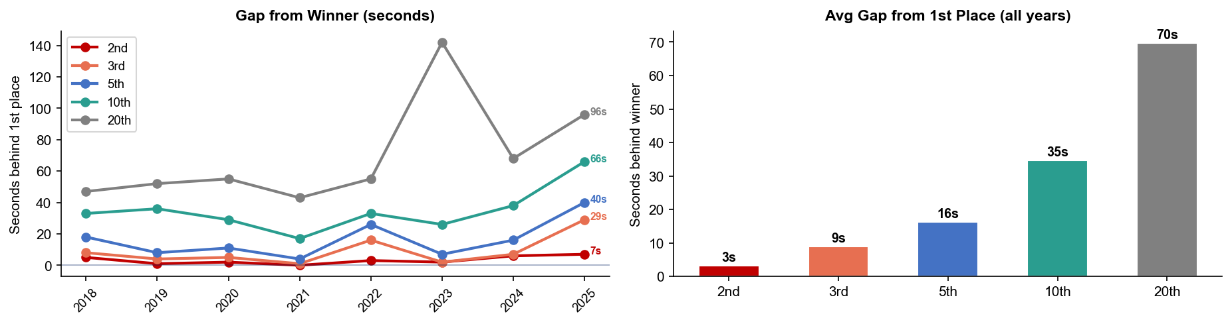
Key Position Times — Elite Men
Hamburg
Year | 1st | 2nd | 3rd | 5th | 10th | 20th
2018 | 53:24 | 53:29 +5s | 53:32 +8s | 53:42 +18s | 53:57 +33s | 54:11 +47s
2019 | 55:09 | 55:10 +1s | 55:13 +4s | 55:17 +8s | 55:45 +36s | 56:01 +52s
2020 | 49:13 | 49:15 +2s | 49:18 +5s | 49:24 +11s | 49:42 +29s | 50:08 +55s
2021 | 53:08 | 53:08 | 53:09 +1s | 53:12 +4s | 53:25 +17s | 53:51 +43s
2022 | 53:10 | 53:13 +3s | 53:26 +16s | 53:36 +26s | 53:43 +33s | 54:05 +55s
2023 | 19:26 | 19:28 +2s | 19:28 +2s | 19:33 +7s | 19:52 +26s | 21:48 +142s
2024 | 50:03 | 50:09 +6s | 50:10 +7s | 50:19 +16s | 50:41 +38s | 51:11 +68s
2025 | 50:07 | 50:14 +7s | 50:36 +29s | 50:47 +40s | 51:13 +66s | 51:43 +96s

Slide 22
Race Conditions — Elite Men
Hamburg
Year | Date | Air Temp | Humidity | Wind (km/h) | Precip (mm) | Water Temp | Wetsuit | Conditions
2018 | Jul 14 | 21 | 68% | 11 | 0.0 | 20.9 | forbidden | —
2019 | Jul 06 | 15.0°* | 90% | 15 | 1.1 | — | — | —
2020 | Sep 05 | 14.5°* | 85% | 18 | 0.3 | — | — | —
2021 | Sep 18 | 15.5°* | 84% | 10 | 0.0 | — | — | —
2022 | Jul 09 | 23.4 | 81% | 19 | 0.1 | 20.8 | forbidden | —
2023 | Jul 15 | 24.4°* | 54% | 14 | 0.0 | — | forbidden | —
2024 | Jul 13 | 18.9 | 74% | 22 | 0.1 | 21.3 | forbidden | —
2025 | Jul 12 | 23.6 | 77% | 14 | 0.8 | 21.1 | forbidden | —
Air temp, humidity, wind, and precipitation sourced from Open-Meteo historical archive (race window 08:00–11:00 local) where WT API data is absent. Values marked * are Open-Meteo estimates. Water temp and wetsuit ruling are from the World Triathlon API per program.

Slide 23
ELITE WOMEN

Slide 24
Race Overview — Elite Women
Hamburg
RACE HISTORY AT HAMBURG
3 KEYS TO SUCCESS
The Elite Women race at Hamburg has been held 8 times in this analysis window (2018–2025). Cassandre Beaugrand is the most successful athlete in this span with 3 victories. The event is staged as part of the World Championship Series / World Championships, World Championship Series calendar. [PLACEHOLDER: Add 1–2 sentences on notable storylines, competitive history, or what makes this event significant for Elite Women athletes. E.g. defending champions, record performances, dramatic finishes.]
1
Swim positioning matters — an average of 18 athletes exit the water within 15 sec of the leader. Entering the bike in the front pack is critical; conserve energy with a disciplined swim line rather than sprinting alone.
2
[PLACEHOLDER: Key 2 — Describe bike strategy: is this a pack race or do breakaways form? What power/tactics are needed to stay in the lead group?]
3
Run speed separates the podium — the fastest run pace averages ~1:28/km with a ~66s spread between fastest and average finisher. Either a pre-built lead from the bike or exceptional run speed is required to win.

Slide 25
Results Summary — Elite Women
Hamburg
Year | Date | Category | Field | DNF/LAP/DNS | Winner | Winner Time | Air Temp | Water Temp | Swim km | Bike km | Run km
2018 | Jul 14 | World Championship Series | 56 | 8 | Beaugrand | 58:06 | 20.9 | 21.3 | 0.75 | 21.0 | 5.0
2019 | Jul 06 | World Championship Series * | 53 | 6 | Stanford | 59:24 | 15.0°* | — | — | — | —
2020 | Sep 05 | World Championships, World Championship Series | 65 | 5 | Taylor-Brown | 54:16 | 14.5°* | — | — | — | —
2021 | Sep 18 | World Championship Series | 46 | — | Lindemann | 58:17 | 15.5°* | — | — | — | —
2022 | Jul 09 | World Championship Series * | 56 | 3 | Duffy | 58:37 | 22.5 | 20.4 | 0.75 | 21.0 | 5.0
2023 | Jul 15 | World Championships, World Championship Series, Age-Group Event * | 57 | 1 | Beaugrand | 21:35 | 24.4°* | — | 0.30 | 7.5 | 1.75
2024 | Jul 13 | World Championship Series * | 55 | 4 | Beaugrand | 55:19 | 19.2 | 21.2 | 0.75 | 19.8 | 4.9
2025 | Jul 12 | World Championship Series * | 55 | 3 | Periault | 56:25 | 21.3 | 21. | 0.75 | 19.8 | 5.0
* Course distance changed vs. prior year

Slide 26
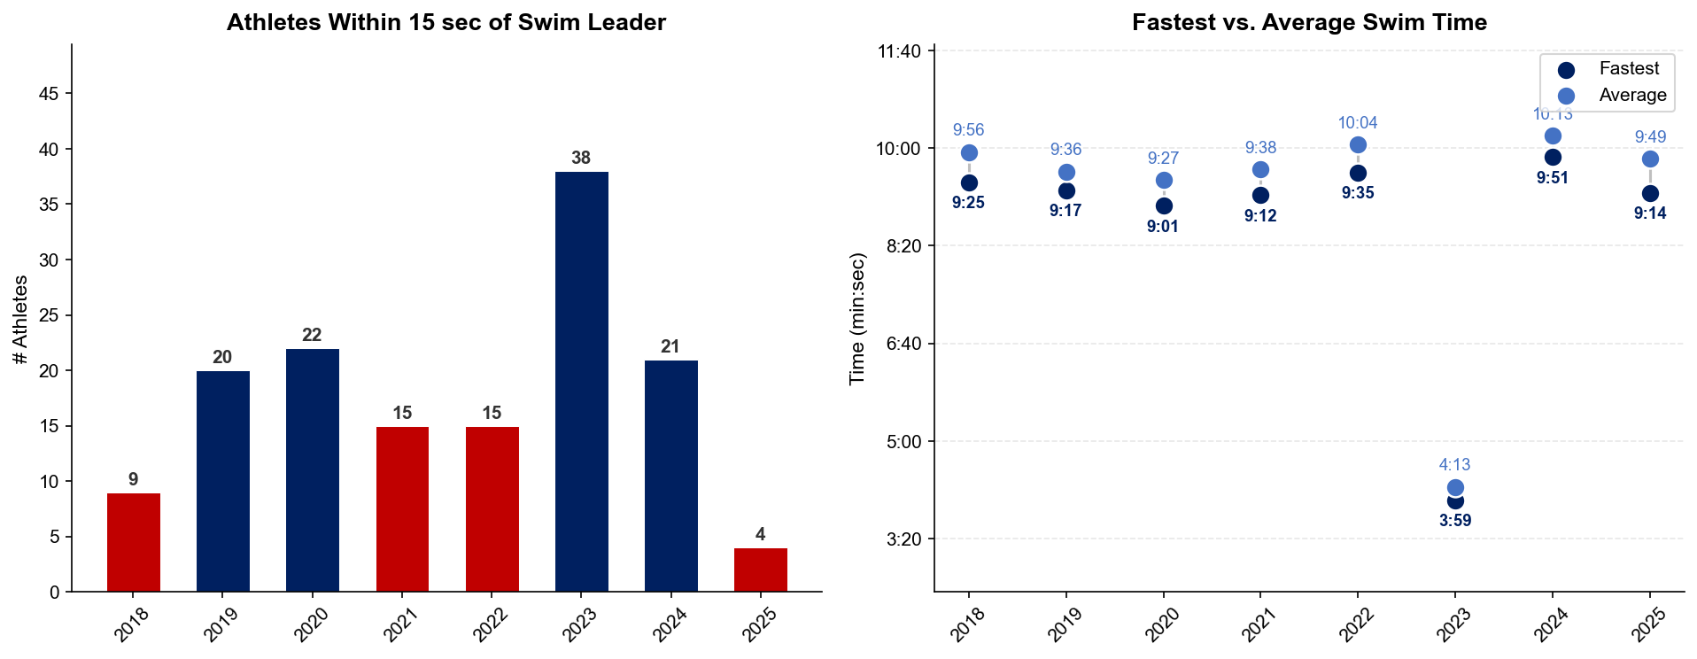
Swim Exit Dynamics — Elite Women
Hamburg

Slide 27
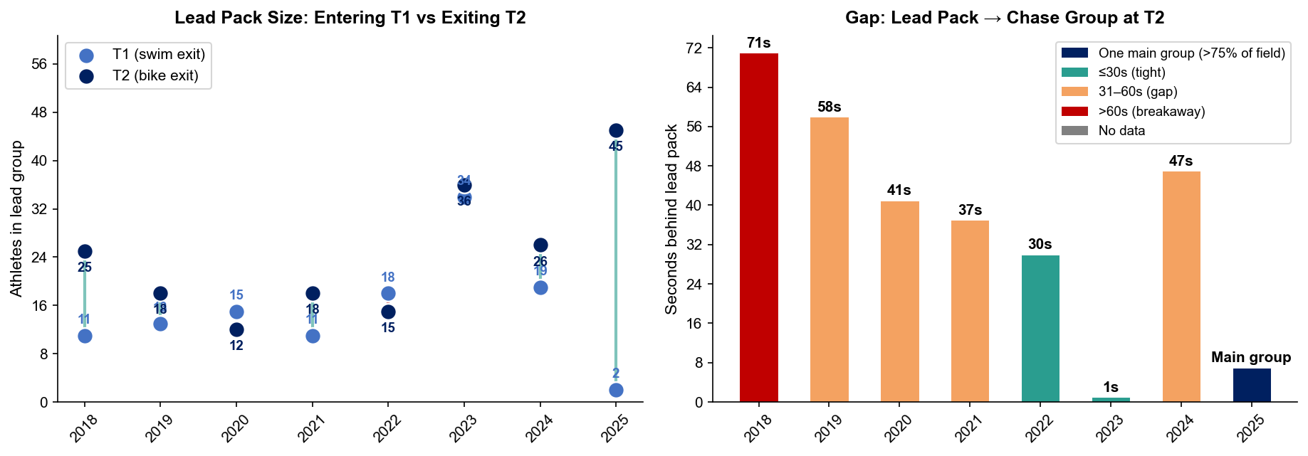
Bike Pack Evolution — Elite Women
Hamburg
Lead pack = athletes within 15 sec of leader. T1 = lead group entering the bike; T2 = lead group exiting the bike.
Year | Lead Size @ T1 | Lead Size @ T2 | Change | Chase Group @ T2 | Chase Gap*
2018 | 11 | 25 | +14 | 12 | 71s
2019 | 13 | 18 | +5 | 7 | 58s
2020 | 15 | 12 | -3 | 5 | 41s
2021 | 11 | 18 | +7 | 13 | 37s
2022 | 18 | 15 | -3 | 27 | 30s
2023 | 34 | 36 | +2 | 11 | 1s
2024 | 19 | 26 | +7 | 10 | 47s
2025 | 2 | 45 | +43 | 7 | 82s
Lead pack = athletes within 15 sec of leader. Chase group = athletes within 15 sec of the first athlete outside the lead pack. * Chase Gap = seconds from the last lead-pack athlete to the first chase-group athlete at T2.
Dropouts: 2018: 6 DNF/LAP | 2019: 5 DNF/LAP | 2020: 5 DNF/LAP | 2022: 2 DNF/LAP (1 in lead group at t1) | 2024: 3 DNF/LAP (1 in lead group at t1) | 2025: 3 DNF/LAP

Slide 28
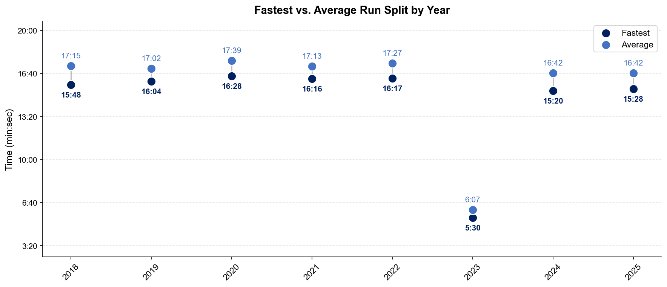
Run Split Analysis — Elite Women
Hamburg

Slide 29
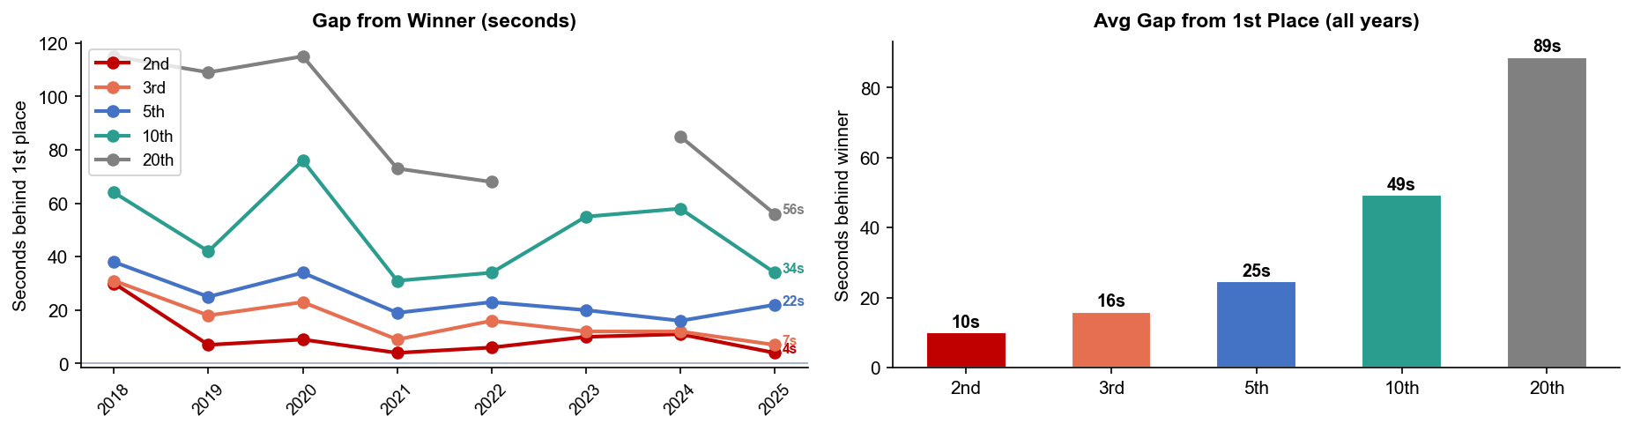
Key Position Times — Elite Women
Hamburg
Year | 1st | 2nd | 3rd | 5th | 10th | 20th
2018 | 58:06 | 58:36 +30s | 58:37 +31s | 58:44 +38s | 59:10 +64s | 1:00:01 +115s
2019 | 59:24 | 59:31 +7s | 59:42 +18s | 59:49 +25s | 1:00:06 +42s | 1:01:13 +109s
2020 | 54:16 | 54:25 +9s | 54:39 +23s | 54:50 +34s | 55:32 +76s | 56:11 +115s
2021 | 58:17 | 58:21 +4s | 58:26 +9s | 58:36 +19s | 58:48 +31s | 59:30 +73s
2022 | 58:37 | 58:43 +6s | 58:53 +16s | 59:00 +23s | 59:11 +34s | 59:45 +68s
2023 | 21:35 | 21:45 +10s | 21:47 +12s | 21:55 +20s | 22:30 +55s | —
2024 | 55:19 | 55:30 +11s | 55:31 +12s | 55:35 +16s | 56:17 +58s | 56:44 +85s
2025 | 56:25 | 56:29 +4s | 56:32 +7s | 56:47 +22s | 56:59 +34s | 57:21 +56s

Slide 30
Race Conditions — Elite Women
Hamburg
Year | Date | Air Temp | Humidity | Wind (km/h) | Precip (mm) | Water Temp | Wetsuit | Conditions
2018 | Jul 14 | 20.9 | 68% | 11 | 0.0 | 21.3 | forbidden | —
2019 | Jul 06 | 15.0°* | 90% | 15 | 1.1 | — | — | —
2020 | Sep 05 | 14.5°* | 85% | 18 | 0.3 | — | — | —
2021 | Sep 18 | 15.5°* | 84% | 10 | 0.0 | — | — | —
2022 | Jul 09 | 22.5 | 81% | 19 | 0.1 | 20.4 | forbidden | —
2023 | Jul 15 | 24.4°* | 54% | 14 | 0.0 | — | forbidden | —
2024 | Jul 13 | 19.2 | 74% | 22 | 0.1 | 21.2 | forbidden | —
2025 | Jul 12 | 21.3 | 77% | 14 | 0.8 | 21. | forbidden | —
Air temp, humidity, wind, and precipitation sourced from Open-Meteo historical archive (race window 08:00–11:00 local) where WT API data is absent. Values marked * are Open-Meteo estimates. Water temp and wetsuit ruling are from the World Triathlon API per program.

